Slide 1
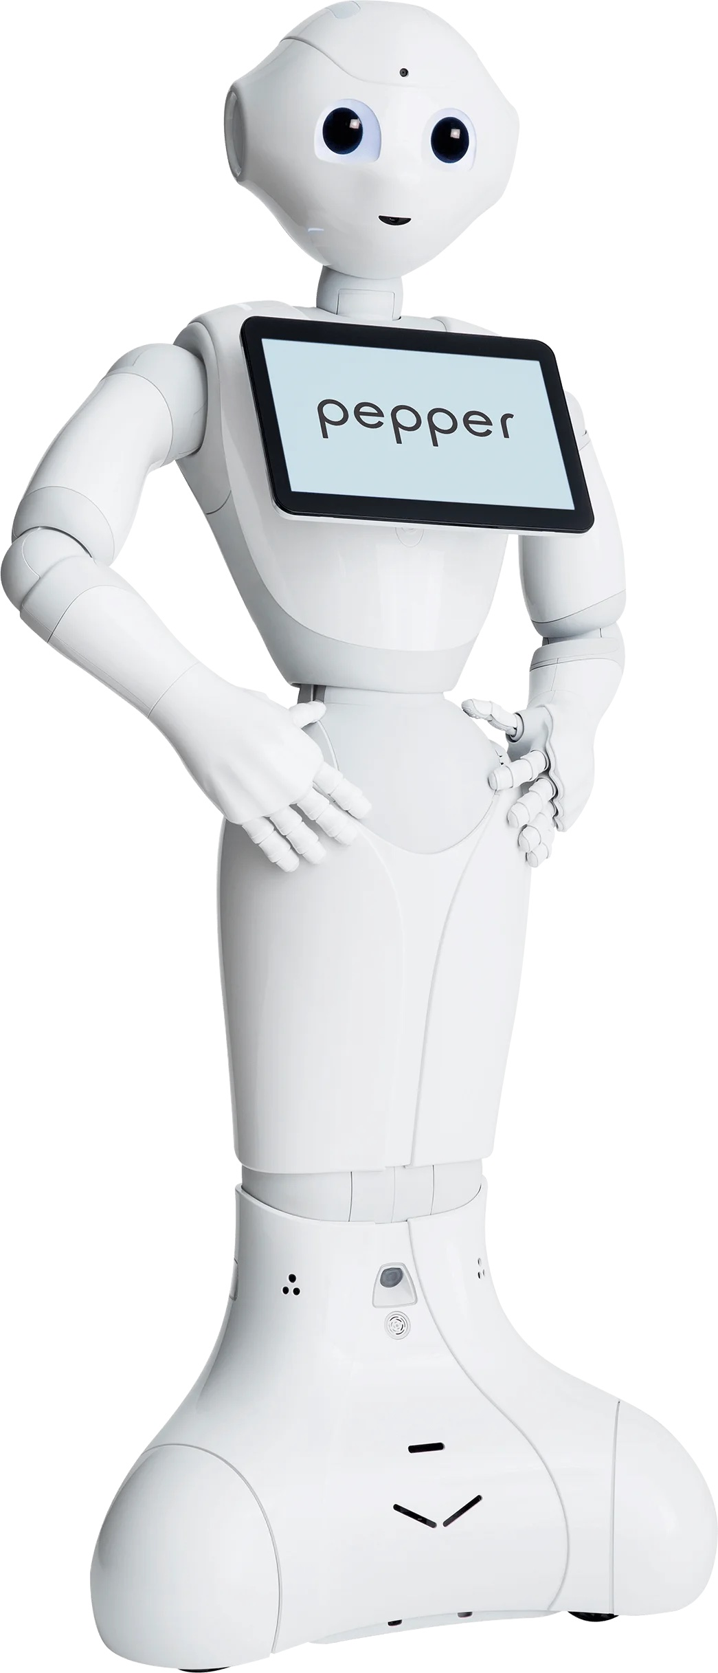
Pepper Medical Assistance Robot

Slide 2
Team Members
Aly Ahmed Lotfy Intelligent System 221000412
Abdulrahman Karam Intelligent System 221002035
Mohammed El Maghwary Intelligent System 221001747
Amira El Sayed Data Science 221002982
Amr Sherif Emara Data Science 221000299
Youssef Ahmed Tawfik Data Science 221001264

Slide 3
Objectives
Introduce the Project
Explain the Motivation
Demonstrate the System Design and Architecture
Detail the Development Process
Showcase Key Features
Share Testing and Results
Outline Future Work.
Engage the Audience

Slide 4
Why Choose Pepper
Content:
Versatile Interaction: Pepper can interact with users through speech, gestures, and a tablet interface, making it ideal for patient interactions.
Bilingual Support: Pepper can interact in multiple languages, making it suitable for diverse patient groups.
Established Robot for Healthcare: Pepper is used in multiple healthcare settings around the world, making it a trusted platform.
Emotional Interactions: Pepper can engage with patients emotionally, which can reduce stress and improve patient experience.
Adaptability: Can be integrated with external systems (backend servers, databases) and customized for various healthcare needs.

Slide 5
Project Goal
Content:
Goal: Build a Pepper Medical Assistant Robot for real-world healthcare settings.
Specific Objectives:
Provide interactive medical assistance to patients.
Ensure efficient integration with hospital systems.
Facilitate real-time communication between the robot and hospital staff.
Create an interface that can be used by elderly patients with ease.

Slide 6
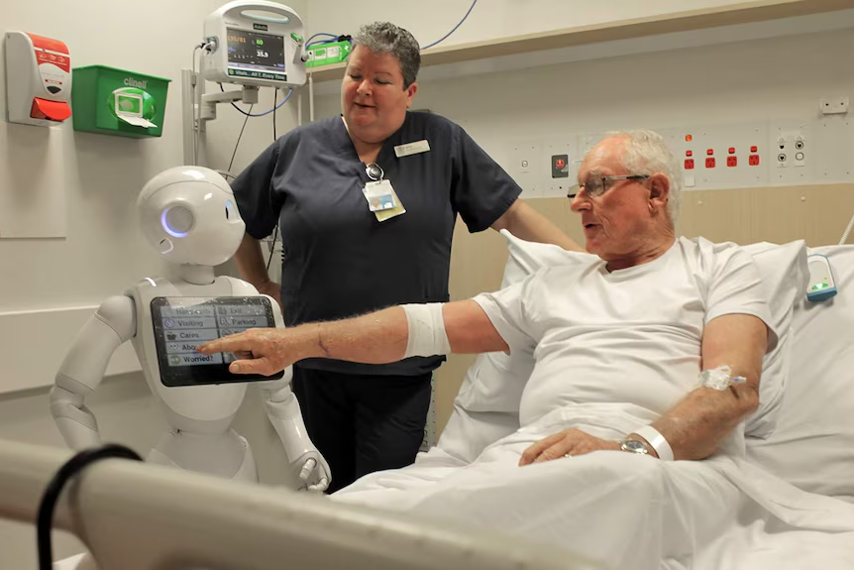
Project Vision
AI-powered medical assistant robot to improve patient experience.
Collaboration with Andalusia Hospital.
Provides bilingual (Arabic/English) interaction for accessibility.
Focus: Reception, FAQ, Triage, and Nurse Alert

Slide 7
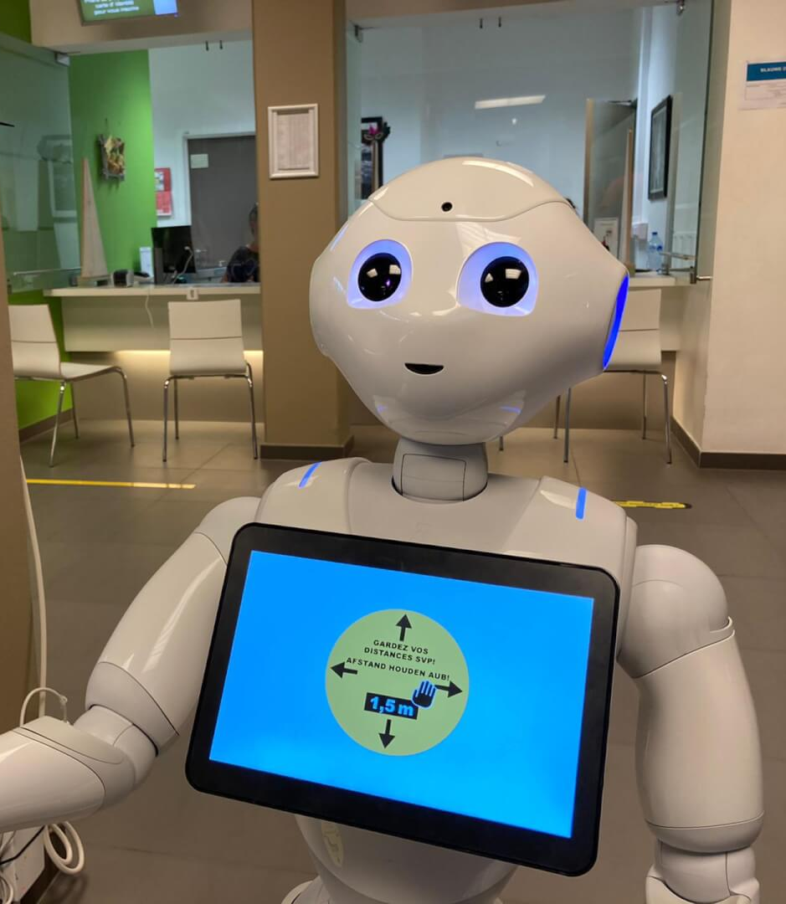
Core Features
Reception & Check-in: confirm appointments via ID/QR.
Queue Management: show wait times, notify patients.
FAQs & Guidance: answer hospital-related queries.
Wayfinding: give directions to departments.
Simple Triage: detect urgent cases and alert nurses
Navigation: Help Patient through the hospital

Slide 8
Future Work
Advanced Triage System
Pepper Guidance through building
Pepper Teleoperation
Bilingual System

Slide 9
Why Robotics in HealthCare
Content:
Improved Patient Experience: Robots like Pepper reduce anxiety and improve patient interactions.
Support for Healthcare Workers: Pepper assists staff by reducing their workload, allowing them to focus on critical tasks.
Data Collection: Robots collect valuable data from patients, enabling more efficient decision-making in the hospital setting.
Increased Efficiency: Automation of tasks such as triage and frequently asked questions reduces waiting times and enhances operational efficiency.

Slide 10
Advanced AI Features
Autonomous navigation to guide patients.
Integration with hospital EMR systems.
Advanced triage (vitals monitoring, AI-based assessment).
Telepresence capabilities(Case Study)

Slide 11
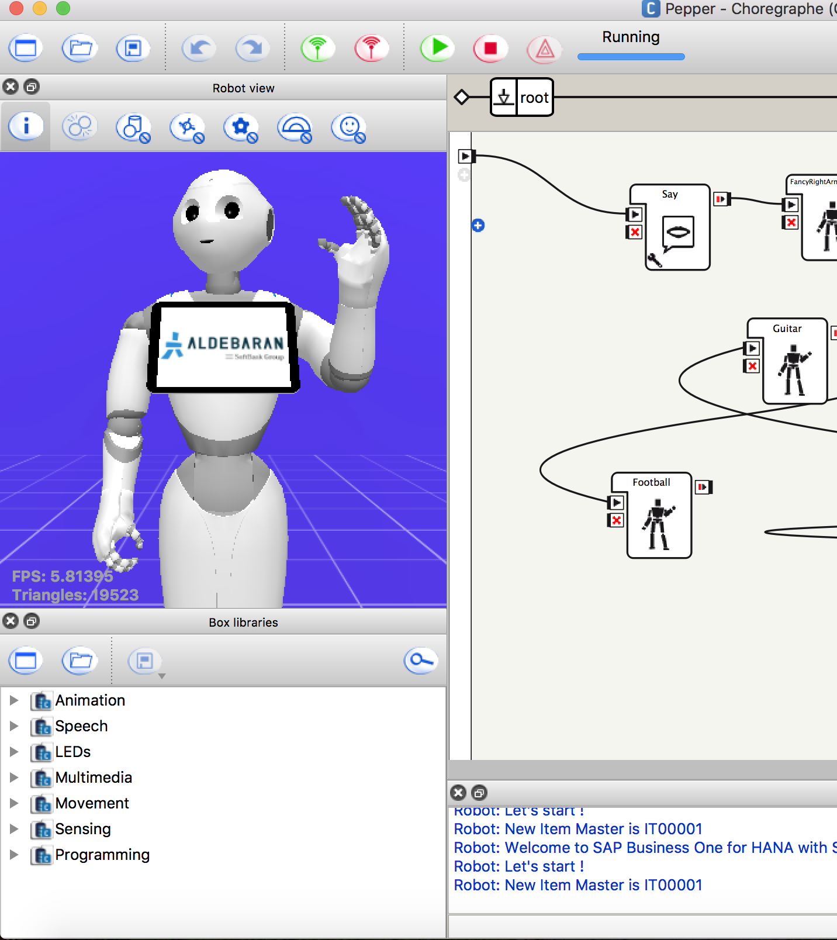
System Architecture
Pepper Layer: NAOqi (Python 2.7) → speech, gestures, tablet.
Backend Layer: FastAPI (Python 3) → RAG FAQ + triage + WebSocket.
UI Layer: Tablet web app (HTML/CSS/JS). ➡ Fully local system → privacy-first, low late

Slide 12
How Did We Do It? – Initial Setup
Title: Initial Setup and System Preparation
Content:
Step 1: Pepper robot setup – connecting the robot to the hospital’s Wi-Fi and ensuring basic functionality (movement, camera, microphone).
Step 2: Installed the NAOqi SDK (Python 2.7) for robot communication.
Step 3: Developed the backend server (FastAPI) to handle requests, process triage, and manage patient data.
Step 4: Created the tablet UI for Pepper, ensuring a user-friendly interface with large buttons and bilingual support (Arabic and English).

Slide 13
System Components
Title: System Components and Their Role
Content:
Pepper Robot: Interaction device for speech, gestures, and tablet-based assistance.
Backend Server (FastAPI): Handles all API requests, connects to the robot via WebSocket, manages database interactions, and processes triage.
Tablet UI: A web app displayed on Pepper’s tablet, where patients interact by typing or using voice input for check-in, FAQs, and triage.
WebSocket Bridge: Facilitates communication between Pepper and the backend server, ensuring real-time interaction.

Slide 14
Integration of Speech Recognition (Whisper)
Title: Integration of Speech Recognition and Processing
Content:
Whisper: Used for transcribing audio recorded by Pepper’s microphones into text.
Workflow:
Pepper records a patient's question.
Audio is sent to the backend server for processing.
The backend transcribes the audio and retrieves the answer from the FAQ database or triage logic.
Pepper speaks the answer and displays it on the tablet.
Challenges: Speech recognition accuracy in noisy environments, especially in a hospital lobby with multiple patients.

Slide 15
WebSocket Communication
Title: WebSocket Communication – Connecting Pepper and the Backend
Content:
WebSocket Bridge: The WebSocket bridge allows real-time bidirectional communication between the backend server and the Pepper robot.
Purpose: It sends commands (e.g., TTS, tablet display updates) to the robot and receives responses from the robot.
How It Works:
The backend sends a message to Pepper to speak (via ALTextToSpeech) or display a webpage (via ALTabletService).
It also handles alerts in case of urgent medical conditions (triggered by the triage module).

Slide 16
Tablet Interface Design
Title: Design of Pepper’s Tablet Interface
Content:
UI Design Principles:
Accessibility: Large fonts, big buttons, and simple navigation for elderly patients.
Bilingual: The interface is in Arabic and English to accommodate diverse patients.
Features on Tablet:
Check-in Form: Patient enters their ID or appointment number.
FAQ Section: Patients can ask about hospital services, visiting hours, etc.
Triage Section: Patients can answer yes/no questions about their symptoms.

Slide 17
My Appointments
Content:
Purpose: Allow patients to view their upcoming appointments.
User Interaction: Patients can click the "My Appointments" button to view their schedule.
Benefit: This feature streamlines appointment management and helps patients stay informed about their upcoming visits.

Slide 18
My Appointments (Technical Details)
Content:
Backend Integration: The backend server fetches appointment data from a database (SQLAlchemy).
UI Display: The Pepper tablet UI fetches the data from the backend API and displays the user's appointments.
Technologies Used: FastAPI for backend API, SQLAlchemy for database integration, and WebSocket for communication with Pepper.

Slide 19
Health Tips (Overview)
Title: Feature 2 – Health Tips
Content:
Purpose: Provide patients with health-related tips or general wellness advice.
User Interaction: Patients tap the "Health Tips" button to view helpful tips and advice.
Benefit: Helps patients maintain better health awareness during their visit.

Slide 20
Health Tips (Technical Implementation)
Title: Feature 2 – Health Tips (Technical Details)
Content:
Backend Integration: Health tips are stored in the database and retrieved via an API when the user taps the "Health Tips" button.
Content Delivery: Tips are displayed on the tablet using the HTML UI.
Technologies Used: FastAPI to fetch health tips, and WebSocket to display the tips on the Pepper tablet UI.

Slide 21
Chat/FAQ (Overview)
Title: Feature 3 – Chat/FAQ
Content:
Purpose: Allows patients to ask common questions (e.g., visiting hours, insurance details) and receive instant responses.
User Interaction: Patients can type or speak their queries into the chatbot interface.
Benefit: Improves patient experience by providing quick access to hospital-related information.

Slide 22
Feature 3 – Chat/FAQ (Technical Implementation)
Title: Feature 3 – Chat/FAQ (Technical Details)
Content:
FAQ Database: FAQ data is stored and indexed in a database using the RAG (Retrieval-Augmented Generation) approach.
Speech-to-Text: Whisper is used to convert patient speech into text for the FAQ system.
Technologies Used: FastAPI for backend, Whisper for speech recognition, RAG for FAQ response retrieval, and WebSocket for communication with Pepper.

Slide 23
Feature 4 – About (Overview)
Title: Feature 4 – About
Content:
Purpose: Provides an introduction to Pepper and its capabilities.
User Interaction: Patients tap "About" to get information on how to interact with the robot and its features.
Benefit: Enhances patient understanding of how to use the robot and its functionalities

Slide 24
Feature 5 – Book Appointment (Overview)
Title: Feature 5 – Book Appointment
Content:
Purpose: Allows patients to book an appointment with the hospital.
User Interaction: Patients tap the "Book Appointment" button, enter required details (name, time, etc.), and book an appointment.
Benefit: Streamlines the appointment booking process, making it more accessible for patients.

Slide 25
Feature 5 – Book Appointment (Technical Implementation)
Title: Feature 5 – Book Appointment (Technical Details)
Content:
Backend Integration: The backend validates the appointment details and stores the new appointment in the database.
UI Interaction: The tablet displays a booking form that collects necessary information.
Technologies Used: FastAPI for appointment booking API, SQLAlchemy for storing appointment data.

Slide 26
Feature 6 – Check Schedule (Overview)
Title: Feature 6 – Check Schedule
Content:
Purpose: Allows patients to check available schedules for doctors.
User Interaction: Patients select a doctor and view available slots.
Benefit: Makes it easy for patients to check doctor availability and plan their visit accordingly.

Slide 27
Feature 6 – Check Schedule (Technical Implementation)
Title: Feature 6 – Check Schedule (Technical Details)
Content:
Backend Integration: The backend fetches the doctor's schedule from the database and provides available time slots.
UI Display: The tablet displays available schedules in a user-friendly format.
Technologies Used: FastAPI for fetching doctor schedules, SQLAlchemy for database queries.

Slide 28
Feature 7 – Guide to Room (Overview)
Title: Feature 7 – Guide to Room
Content:
Purpose: Helps patients navigate through the hospital and find their designated room or department.
User Interaction: Patients tap the "Guide to Room" button, and Pepper provides directions.
Benefit: Reduces confusion and improves the patient experience by guiding them to the right location.

Slide 29
Feature 7 – Guide to Room (Technical Implementation)
Title: Feature 7 – Guide to Room (Technical Details)
Content:
Backend Integration: The backend provides the directions based on the patient's location and destination.
UI Interaction: The tablet displays a map or directions on the screen.
Technologies Used: WebSocket to send directions to the tablet, mapping data integration.

Slide 30
: Feature 8 – Emergency (Overview)
Title: Feature 8 – Emergency
Content:
Purpose: Enables patients to trigger an emergency alert if they need immediate assistance.
User Interaction: Patients tap the "Emergency" button, and an alert is triggered.
Benefit: Provides a quick way for patients to alert hospital staff to urgent situations.

Slide 31
Feature 8 – Emergency (Technical Implementation)
Title: Feature 8 – Emergency (Technical Details)
Content:
Backend Integration: The backend triggers an alert to the hospital staff when the emergency button is pressed.
UI Interaction: The tablet displays a confirmation message and sends the alert.
Technologies Used: WebSocket communication to trigger the emergency alert and backend API for notifying hospital staff.

Slide 32
Triage Logic and Nurse Alert System
Title: Triage Logic and Nurse Alert System
Content:
Triage Logic:
Simple yes/no questions are asked to assess the severity of symptoms.
A rule-based scoring system determines whether the case is urgent or not.
Nurse Alerts:
If the triage score indicates a high-risk case, a nurse alert is triggered.
Alert Mechanism: Pepper announces the alert and optionally sends a notification to hospital staff.

Slide 33
Challenges Faced
Title: Challenges and Solutions
Content:
Speech Recognition in Noisy Environments:
Solution: Use Whisper with noise reduction techniques and optimize mic sensitivity.
Bilingual Support:
Solution: Ensure Whisper is capable of recognizing both Arabic and English queries accurately.
System Integration:
Solution: Extensive testing to ensure smooth communication between the robot, backend server, and UI.

Slide 34
Implementation Timeline
Phase | Weeks | Focus
Kickoff & Setup | 1–2 | Environment, role assignments
Core Dev | 3–5 | Backend, UI, RAG, Triage
Integration & Mid-Demo | 6–15 | Voice, bilingual FAQ, check-in
Expansion | 15–22 | Triage conversation, nurse alert
Pilot Deployment | 23-25 | Hospital testing & evaluation
Finalization | 26-30 | Report, final demo, handover

Slide 35
Testing and Pilot
Title: Testing and Pilot Deployment
Content:
Pilot Testing at Andalusia Hospital:
Deployed Pepper for real-world testing in a hospital setting.
Focused on patient check-ins, FAQ responses, and triage functionality.
Results: Positive feedback from hospital staff, with improvements suggested for better integration with the hospital’s existing systems.
Metrics Collected: Response time, patient satisfaction, and error rates.

Slide 36
Conclusion
Title: Conclusion
Content:
The Pepper Medical Assistance Robot improves patient interactions in healthcare settings by providing assistance with check-ins, FAQs, triage, and alerts.
The project demonstrates the potential of robots in enhancing hospital efficiency and patient experience.
With future enhancements, Pepper could become a valuable tool for various healthcare tasks, reducing human workload and improving service delivery.

Slide 37
Acknowledgements
Title: Acknowledgements
Content:
Special thanks to Andalusia Hospital for their collaboration in testing the system.
Appreciation for the support from faculty mentors and the College of Artificial Intelligence at AAST.
Gratitude to team members for their hard work and dedication throughout the project.

Slide 38
Questions & Answers
Title: Questions & Answers
Content:
"Thank you for your attention. I am happy to answer any questions you may have."

Slide 39
Thank you

